Slide 1



Case 2
Raj
LDL-C:
How Low Do You Go?
ASCVD: atherosclerotic cardiovascular disease

Slide 2

Learning Objectives
Upon completion of this case based session, participants will be able to:
01
Apply the recent CCS Dyslipidemia guidelines to clinical practice
Discuss the importance of lowering LDL-C to target and selecting the appropriate therapeutic options to achieve guideline recommended targets
02
03
Explain the evidence and safety of achieving very low LDL-C levels

Slide 3


Case 2
Raj
60 years old
Raj, a 60 year old IT executive with a good private insurance plan, presents to your office for a routine follow-up appointment post labs.
He is looking forward to retiring soon.

Slide 4


Case 2
Raj
60 years old
Raj’s History
Experienced NSTEMI 2 months earlier (stent x 2)
Ex-smoker (just quit after MI)
Hypertension
Family history of CVD
Physical Exam
Weight 95.3 kg
Height 1.90 m
BMI 27.7 kg/m²
BP 132/84 mmHg
HR 70 BPM regular
Echo preserved LV function

Slide 5


Case 2
Raj
60 years old
Medications
Atorvastatin 80 mg qhs
Aspirin 75 mg OD
Clopidogrel 75mg OD
Bisoprolol 5 mg OD
Perindopril 8 mg OD
Labs
eGFR 56 ml/min
LDL-C 2.6 mmol/L

Slide 6
Case 2
Raj
60 years old
Raj is complaining of myalgias on atorvastatin 80 mg daily and wants to stop taking his statin

Slide 7


2016 CCS Lipid Guidelines Recommend: Targeting Lower LDL-C to Lower the Risk for CV Events
TREATMENT TARGETS:
STATIN INDICATED CONDITIONS
LDL-C consistently <2.0 mmol/L or >50% reduction
Consider <1.8 mmol/L in patients with clinical atherosclerosis
Apo B ≤0.80 g/L or non-HDL-C ≤2.6 mmol/L can be considered as alternative treatment targets
(those who will benefit the most):
Clinical atherosclerosis*
Abdominal aortic aneurysm
Most diabetes mellitus
CKD (age >50 years)
LDL-C ≥5.0 mmol/L
*Clinical atherosclerosis, i.e., previous MI, or coronary revascularization by PCI or CABG surgery, other arterial revascularization procedures, angina pectoris, cerebrovascular disease including TIA, or peripheral arterial disease (claudication and/or ABI <0.9)
ABI, ankle brachial index; Apo B, apolipoprotein B; CABG, coronary artery bypass graft surgery; CCS, Canadian Cardiovascular Society; CKD, chronic kidney disease; CV, cardiovascular; HDL-C, high-density lipoprotein cholesterol; LDL-C, low-density lipoprotein cholesterol; MI, myocardial infarction; PCI, percutaneous coronary intervention; TIA, transient ischemic attack.
Anderson TJ et al. 2016;32:1263-1282
Notes:
Notes
:
Fortunately, we have conducted many studies such as TNT, PROVE-IT TIMI 22, JUPITER and now IMPROVE-IT where patients have achieved very low levels of LDL-C without major safety concerns emerging.

Slide 8

How would you manage this request from Raj?
Please select from one of the available options
Tell Raj he can stop taking his atorvastatin as he has taken it long enough
Lower his atorvastatin to 40 mg, as he is close to target
Lower his atorvastatin to 40 mg and add ezetemibe 10mg
Switch to rosuvastatin 20 mg

Slide 9
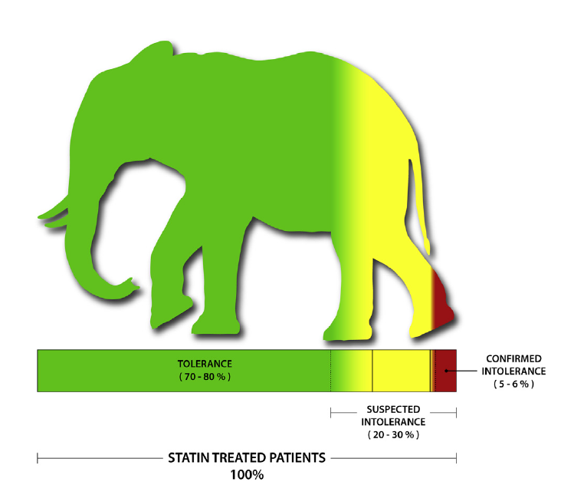

Clinical Experience vs Randomized Clinical Trials: The Elephant in the Room regarding Goal-Inhibiting Statin Intolerance (GISI)
Mancini et al, DOI: http://dx.doi.org/10.1016/j.cjca.2016.01.003
Notes:
Notes
The elephant in the room for statin intolerance. This illustration
attempts to convey the significant effect of suspected statin
intolerance in clinical practice (20%-30% of subjects) compared with
verified statin intolerance. In randomized assessments of patients
with suspected intolerance, many can be excluded through challenge/
dechallenge/rechallenge protocols and drug-/dose-finding attempts.
This process is time-consuming but often effective, leaving a small
minority (5%-6%) with verified intolerance warranting statin-adjunct
and/or statin-replacement medications to achieve therapeutic goals.

Slide 10
Definition of Statin Intolerance
A clinical syndrome (i.e. there is no specific test yet) defined as:
Inability to use statins due to significant symptoms and/or biomarker abnormalities attributed to statin use as determined by stop and re-challenge approach
Either “complete” (intolerant to any statin at any dose) or “partial” (intolerant to some statins at some doses); practically, at least 2 statins
Not due to drug-drug interactions or predisposing factors (e.g. untreated hypothyroidism, febrile illness etc)
Mancini et al Can J Cardiol 2011;27:635-662
Notes:
Notes

Slide 11
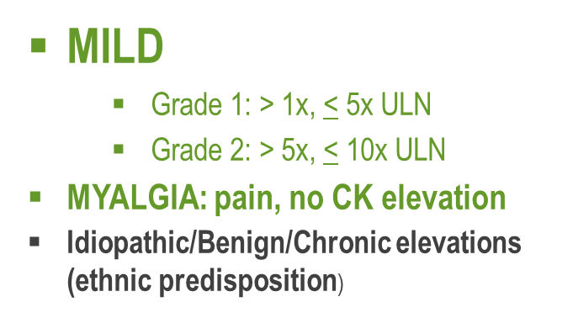
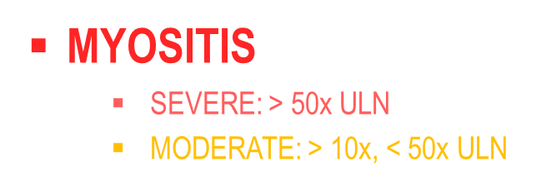


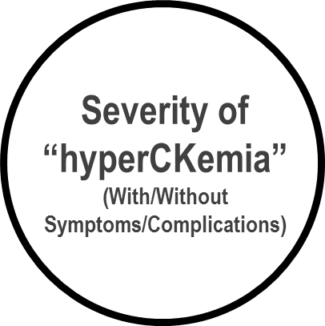



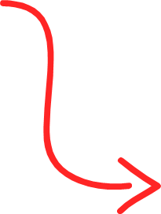
Clinical Features
Myalgia ranging from 1% to 5% in controlled clinical trials to 11% to 29% in observational cohorts
Increase in muscle enzymes, “hyperCKemia”
Clinically evident myopathy with weakness and/or markedly increased serum muscle enzymes (myositis) - rare
Mancini et al Can J Cardiol 2011;27:635-662
Notes:
Notes
Why the big difference between RCT reports and cohort reports?
Individual randomized clinical trials of statins have not shown significant differences of muscle symptoms between statin- and placebo allocated groups
but some dropped patients with muscle or other complaints during the lead-in before randomization
common exclusion criteria for entry into a statin clinical trial have been a previous history of statin intolerance or being on other medications known to increase statin blood levels
clinical trial results are generally powered to show efficacy and may miss adverse effects of any but the most obvious

Slide 12
Why Bother Re-Challenging?
remained on statin 12 months after the initial statin-related discontinuation
92.2 %
were able to tolerate long-term (6-month follow-up) therapy with a stable dosage of statin
72.5 %
Zhang H, Plutzky J, Skentzos S, et al. Discontinuation of statins in routine care settings: a cohort study. Ann Intern Med. 2013;158: 526–534
Mampuya WM, Frid D, Rocco M, et al. Treatment strategies in patients with statin intolerance: the Cleveland Clinic experience. Am Heart J. 2013;166:597–603
Notes:
Notes
Zhang Abstract:
BACKGROUND: Systematic data on discontinuation of statins in routine practice of medicine are limited.
OBJECTIVE: To investigate the reasons for statin discontinuation and the role of statin-related events (clinical events or symptoms believed to have been caused by statins) in routine care settings.
DESIGN: A retrospective cohort study.
SETTING: Practices affiliated with Brigham and Women's Hospital and Massachusetts General Hospital in Boston.
PATIENTS: Adults who received a statin prescription between 1 January 2000 and 31 December 2008.
MEASUREMENTS: Information on reasons for statin discontinuations was obtained from a combination of structured electronic medical record entries and analysis of electronic provider notes by validated software.
RESULTS: Statins were discontinued at least temporarily for 57 292 of 107 835 patients. Statin-related events were documented for 18 778 (17.4%) patients. Of these, 11 124 had statins discontinued at least temporarily; 6579 were rechallenged with a statin over the subsequent 12 months. Most patients who were rechallenged (92.2%) were still taking a statin 12 months after the statin-related event. Among the 2721 patients who were rechallenged with the same statin to which they had a statin-related event, 1295 were receiving the same statin 12 months later, and 996 of them were receiving the same or a higher dose.
LIMITATIONS: Statin discontinuations and statin-related events were assessed in practices affiliated with 2 academic medical centers. Utilization of secondary data could have led to missing or misinterpreted data. Natural-language-processing tools used to compensate for the low (30%) proportion of reasons for statin discontinuation documented in structured electronic medical record fields are not perfectly accurate.
CONCLUSION: Statin-related events are commonly reported and often lead to statin discontinuation. However, most patients who are rechallenged can tolerate statins long-term. This suggests that many of the statin-related events may have other causes, are tolerable, or may be specific to individual statins rather than the entire drug class.
Mampuya Abstract:
BACKGROUND
Statin therapy is a proven effective treatment of hyperlipidemia. However, a significant number of patients cannot tolerate statins. This study was conducted to review treatment strategies for patients intolerant to statin therapy with a focus on intermittent statin dosing.
METHODS AND RESULTS
We performed a retrospective analysis of medical records of 1605 patients referred to the Cleveland Clinic Preventive Cardiology section for statin intolerance between January 1995 and March 2010 with at least a six-month follow-up. The changes in lipid profile, achievement of low-density lipoprotein cholesterol (LDL-C) goals and statin tolerance rate were analyzed. 72.5% of patients with prior statin intolerance were able to tolerate a statin for the median follow-up time of 31 months. Patients on intermittent statin dosing (n=149) had significantly lower LDL-C reduction compared to daily dosing group (n=1014) (21.3±4.0% vs 27.7±1.4%, p<0.001). But compared to the statin discontinued group (n=442), they had a significantly higher LDL-C reduction (21.3±4.0% vs 8.3±2.2%, p<0.001), and a significantly higher portion achieved their ATP–III goal of LDL-C (61% vs 44%, p<0.05). There was a trend toward a decrease in all-cause mortality at 8 years for patients on daily and intermittent statin dosing compared with those who discontinued statin (p=0.08).
CONCLUSIONS
The majority of patients with previous statin intolerance can tolerate subsequent trial of statin. A strategy of intermittent statin dosing can be an effective therapeutic option in some patients and may result in reduction in LDL-C and achievement of LDL-C goals.

Slide 13
Case 2
3 months later…
Raj
60 years old
Raj’s myalgias have resolved on atorvastatin 40 mg OD and ezetimibe 10 mg OD
He feels very well and is looking forward to retirement
His most recent LDL-C is
2.2 mmol/L
Initial Visit LDL-C: 2.6 mmol/L

Slide 14
What is your next plan of action for Raj’s LDL-C management?
Please select from one of the available options
Congratulate him on almost reaching target and see him in 6 months
Try Atorvastatin 80 mg again
Switch to Rosuvastatin 20 mg
Start him on a PCSK9i as he has a good private insurance plan

Slide 15
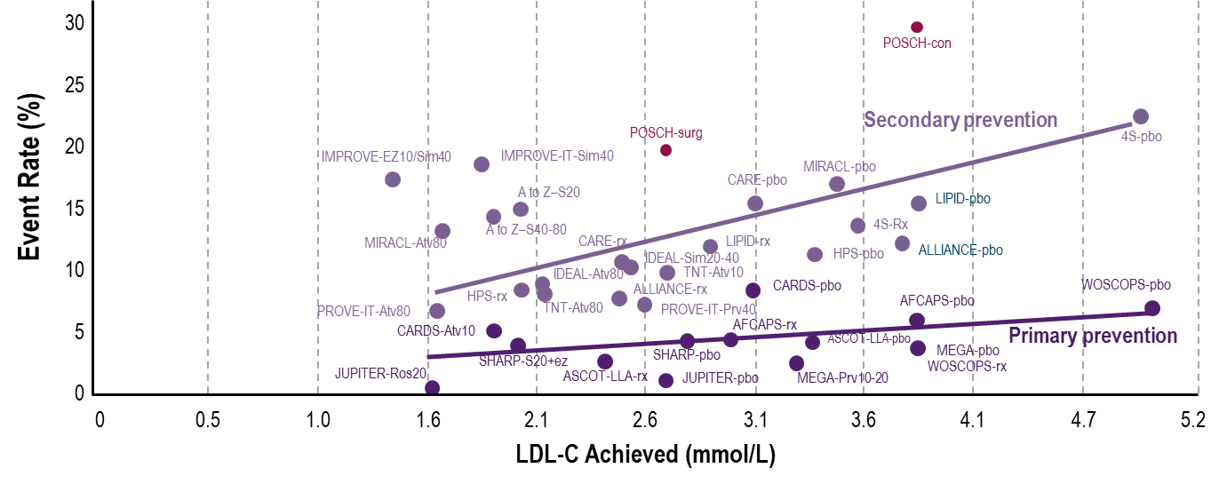
Linear Relationship With Lowering of LDL-C and Reduced CV Events in CV Outcomes Statin Trials
Major Lipid Trials: LDL-C Levels vs. Rates of Coronary Events
Similar associations between LDL-C lowering and reduction of major coronary events were seen in both primary prevention and secondary prevention trials
Note: Line for secondary prevention studies excludes IMPROVE-IT. IMPROVE-IT reflects 7-year rate of major coronary events (nonfatal MI or CHD) and mean LDL-C achieved at year 1.
CV = cardiovascular; LDL-C = low-density lipoprotein cholesterol.
1. Raymond C, et al. Cleve Clin J Med. 2014;81:11-19. 2. Cannon CP, et al. N Engl J Med. 2015;372:2387-2397.
Notes:
Notes

Slide 16
Reduction in CV Events is Proportional to LDL-C Reduction at 1 Year
A prospective meta-analysis of data from 90,056 individuals from 14 trials of statins
A 1 mmol/L reduction in LDL-C was associated with a…
23% reduction in major coronary events
21% reduction in major vascular events
50
50
40
40
30
30
Proportional reduction in event rate (%±SE)
Proportional reduction in event rate (%±SE)
20
20
10
10
0
0
0.5 (19)
1.0 (38)
1.5 (58)
2.0 (77)
0.5 (19)
1.0 (38)
1.5 (58)
2.0 (77)
-10
-10
Reduction in LDL-C mmol/L (mg/dL)
Reduction in LDL-C mmol/L (mg/dL)
Adapted from Baigent C, et al, Cholesterol Treatment Trialists’ (CTT) Collaborators. Lancet 2005;366:1267–1278.

Slide 17
No Evidence for a Lower LDL-C Limit in Reducing Major CV Events
TNT¹
Rate of major CV events*
JUPITER²
Risk of primary endpoint†
PROVE-IT³
Risk of primary endpoint‡
Placebo
> 2.1– 2.6
Referent
≥ 2.7
Not < 1.3 vs placebo
0.76 (0.57–1.00)
2.3 - < 2.7
> 1.6–2.1
0.80 (0.59, 1.07)
2.0 - < 2.3
Achieved LDL-C (mmol/L)
< 1.3 vs placebo
0.35 (0.25–0.49)
> 1.0–1.6
0.67 (0.50, 0.92)
1.7 - < 2.0
P for trend across LDL-C < 0.0001
< 1.3 vs not < 1.3
0.39 (0.26–0.59)
< 1.7
≤ 1.0
0.61 (0.40, 0.91)
0
2
4
6
8
10
12
14
0.1
1
10
0
1
2
% of Patients With Major CV Events
Lower LDL-C Better
Higher LDL-C Better
Lower LDL-C Better
Higher LDL-C Better
*Major CV events for TNT trial were defined as defined as CHD death, nonfatal non-procedured–related MI, resuscitated cardiac arrest, and fatal or nonfatal stroke. †JUPITER primary endpoint was composite of MI, stroke, arterial revascularization, unstable angina, or confirmed death from CV causes. ‡PROVE-IT primary endpoint was composite of death, MI, stroke, revascularization and unstable angina requiring hospital admission.
CHD = coronary heart disease; CV = cardiovascular; LDL-C = low-density lipoprotein cholesterol, MI = myocardial infarction.
LaRosa JC, et al. Am J Cardiol. 2007;100:747-752.
Hsia J, et al. J Am Coll Cardiol. 2011;57:1666-1675.
Wiviott et al. J Am Coll Cardiol. 2005;46:1411-1416.

Slide 18
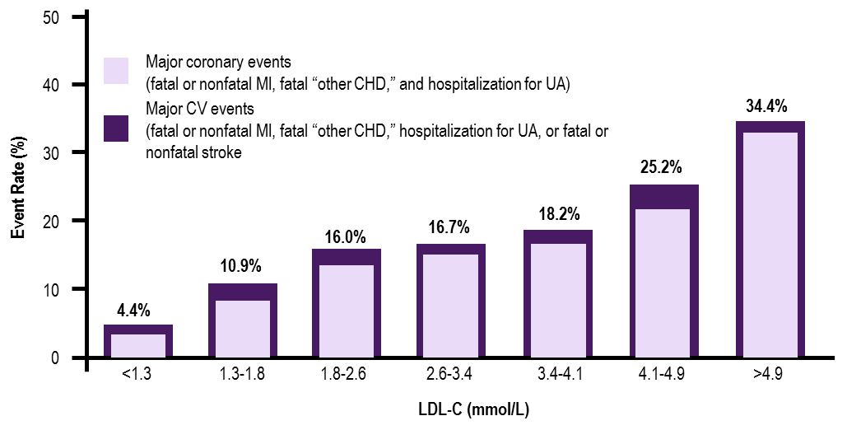
Statin Trials Have Also Shown That Very Low (Vs Moderately Low) LDL-C Is Associated With Significantly Lower Risk
For Major CV Events
CHD, coronary heart disease; CV, cardiovascular; CVD, cardiovascular disease; HR, hazard ratio; LDL-C, low-density lipoprotein cholesterol; MI, myocardial infarction; UA, unstable angina.
Boekholdt SM et al. J Am Coll Cardiol. 2014;64:485-94.

Slide 19
Case 2
3 months later…
Raj
60 years old
Raj is very motivated to stay healthy as he is looking to retire soon.
He has coverage for PCSK9i, so you started him on evolocumab 140 mg sc q2 during his previous visit
(in addition to atorvastatin 40 mg OD).
He stopped taking his
ezetimibe 10 mg OD.

Slide 20
Case 2
3 months later…
Raj
60 years old
Raj saw his labs online and is concerned that his LDL-C may now be “too low”
His most recent LDL-C is
1.2 mmol/L
Previous Visit LDL-C: 2.2 mmol/L
Initial Visit LDL-C: 2.6 mmol/L

Slide 21
What do you do about Raj’s LDL-C level of 1.2 mmol/L?
Please select from one of the available options
You lower the atorvastatin as Raj is now concerned that his LDL-C is too low
You stop his evolocumab and consider trying atorvastatin 80 mg again
You maintain current therapy and explain to Raj, that lower LDL cholesterol affords him additional protection
You lower his evolocumab dose

Slide 22
Low LDL-Cholesterol
Cholesterol is a precursor for synthesis of steroid hormones and is an essential component of all cell membranes
BUT:
Enters the circulation via chylomicrons and VLDL-C, not LDL-C¹
Low levels of LDL-C are present in human neonates and other mammals²
1 Swiger & Martin Drug Saf 2015;38:519-26
2 O’Keefe et al Am J Cardiol 2017;119:565-71
Notes:
Notes

Slide 23
Many Species Have Low Cholesterol, Even During Development
Total Cholesterol of Different Species and Populations¹
Total Cholesterol Levels During Development²
Birth
Weaned
Hunter-gatherer Humans
Hazda
6.5
Breast fed
High fat
Inuit
Ikung
Pygmy
5.2
San
Wild Primates
Baboon
Plasma TC (mmol/L)
Howler Monkey
3.9
Night Monkey
Wild Mammals
2.6
Horse
Boar
Low fat
Paccary
1.3
Formula diet
Black Rhinoceros
African Elephant
Modern Humans
Adult Americans
0
1.3
1.8
2.3
2.9
3.4
3.9
4.4
4.9
5.4
Fetal
Nursing Infant
Adult
Mean Total Cholesterol (mmol/L)
Developmental Period
LDL-C Levels in Humans Increase With Age, Beginning at ~0.78-1.8 mmol/L as Newborns¹ and Typically Rising Above 2.6 mmol/L by Age 20³
LDL-C = low-density lipoprotein-cholesterol; TC = total cholesterol.
O’Keefe JH Jr, et al. J Am Coll Cardiol. 2004;43:2142-2146.
Adapted from Dietschy JM, et al. J Lipid Res. 2004;45:1375-1397.
Cohen JD, et al. Am J Cardiol. 2010;106:969-975.
Notes:
Notes

Slide 24
Low LDL-Cholesterol
Individuals with heterozygous hypobeta-lipoproteinemia have lifelong low total cholesterol and LDL-C (e.g., <1.0 mmol/L)
but have overall excellent health and above average life expectancy (due to the relative absence of atherosclerosis and its complications¹
Loss-of function mutations of PCSK9 (with lifelong extremely low LDL-C levels)
have been described in otherwise healthy individuals^{2,3}
O’Keefe et al Am J Cardiol 2017;119:565-71;
Zhao et al Am J Hum Genet 2006;79:514-23;
Hooper et al Atherosclerosis 2007;193:445-8
Notes:
Notes

Slide 25
Loss-of-function Variants in PCSK9, with Lifetime Low LDL-C, Are Associated With A Lower Risk of CV Events
Genetic PCSK9
LDLR
Serum
LDL-C
CHD
PCSK9 nonsense mutation (n=85)
No PCSK9 nonsense mutation (n=3278)
30
50th percentile
12
P=0.008
20
8
Frequency (%)
CHD (%)
88%
10
4
0
0
1.3
2.6
3.9
5.2
6.5
7.8
No
Yes
Plasma LDL-C in black subjects (mmol/L)
PCSK9 nonsense mutation
In frequency disribution of plasma LDL-C levels, green represents overlap in frequency of patients with and without PCSK9 mutations.
CHD = coronary heart disease; CV = cardiovascular; LDL-C = low-density lipoprotein cholesterol; LDL-R = low-density lipoprotein receptor; PCSK9 = proprotein convertase subtilisin–kexin type 9.
Cohen JC, et al. N Engl J Med. 2006;354;1264-1272.
Notes:
Notes

Slide 26
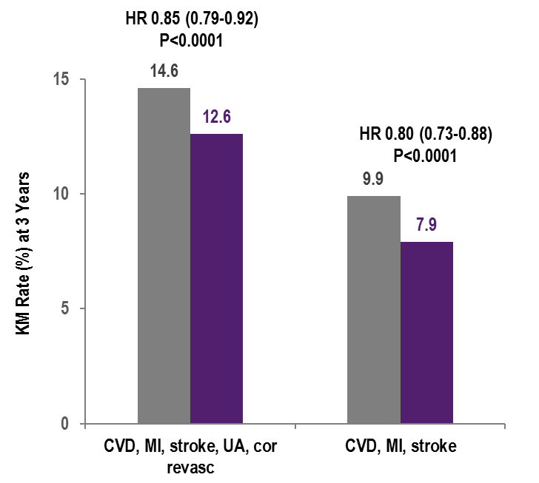
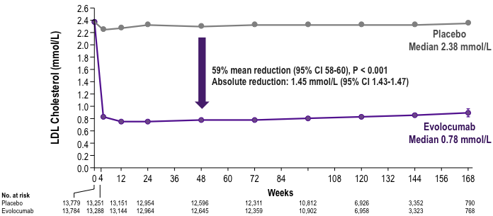
FOURIER
Median LDL-C Levels Over Time
LDL-C was significantly reduced in the evolocumab group (median: 0.78 mmol/L) including 42% who achieved levels ≤ 0.65 mmol/L vs < 0.1% in the placebo group, nearly all of whom were on background statin therapy
↓ CV outcomes
Safe and well-tolerated
Data shown are median values with 95% confidence intervals in the two arms; ITT. Sabatine MS, et al . N Engl J Med 2017; 376:1713-1722

Slide 27
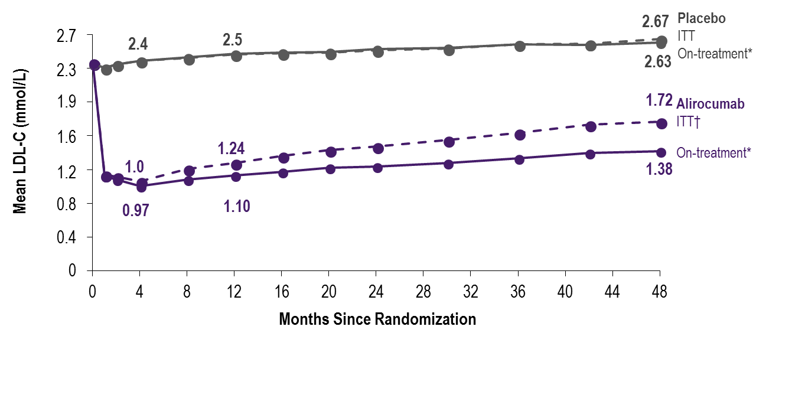
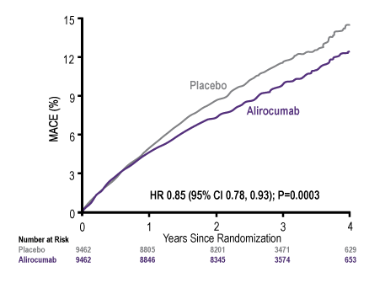
ODYSSEY Outcomes
LDL-C: ITT and On-Treatment Analyses & MACE
MACE: CHD death, non-fatal MI, ischemic stroke, or unstable angina requiring hospitalization
ARR* 1.6%
*Based on cumulative incidence
*Excludes LDL-C values after premature treatment discontinuation or blinded switch to placebo
†All LDL-C values, including those after premature treatment discontinuation, blinded down titration, or blinded switch to placebo
Steg G. et al; On behalf of the ODYSSEY OUTCOMES Investigators and Committees - American College of Cardiology – 67th Scientific Sessions - March 10, 2018

Slide 28
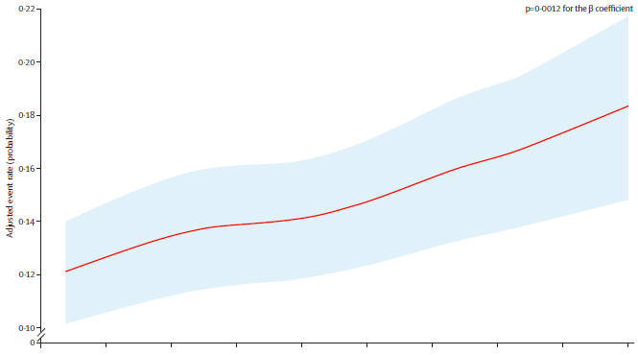
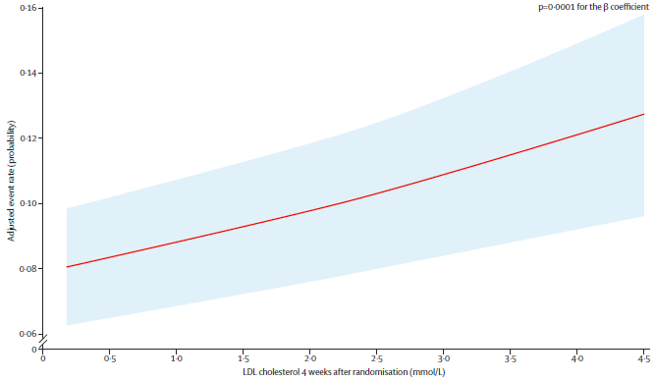
Efficacy of Achieving Very Low LDL-C Concentrations with Evolocumab
Prespecified secondary analysis of 25,982 patients from FOURIER who had an LDL-C measured at 4 weeks and had not experienced a primary endpoint event or one of the ten prespecified safety events before the week-4 visit
CVD, MI, Stroke, UA, or Revasc.
CV Death, MI or Stroke
Monotonic relationship between achieved LDL-C and major CV outcomes down to concentrations <0.2 mmol/L
Giugliano et al Lancet 2017;390:1962-71
Notes:
Notes:

Slide 29
FOURIER
Adverse Events and Laboratory Measures in the Safety Population*
Adverse Events, n (%) | Evolocumab (N = 13,769) | Placebo (N = 13,756)
Injection-site reaction** | 296 (2.1) | 219 (1.6)
Allergic reactions | 420 (3.1) | 393 (2.9)
Muscle-related event | 682 (5.0) | 656 (4.8)
Rhabdomyolysis | 8 (0.1) | 11 (0.1)
Cataract | 228 (1.7) | 242 (1.8)
Adjudicated case of new-onset diabetes† | 677 (8.1) | 644 (7.7)
Neurocognitive event | 217 (1.6) | 202 (1.5)
Laboratory results - n/total n (%)
Aminotransferase >3x ULN | 240/13,543 (1.8) | 242/13,523 (1.8)
Creatinine kinase >5x ULN | 95/13,543 (0.7) | 99/13,523 (0.7)
*Safety evaluations included all randomized patients who received at least one dose of study treatment and for whom post-dose data are available. **The between-group difference was nominally significant (P<0.001). †HR 1.05 (95% CI 0.94-1.17); denominators of 8337 (evolocumab) and 8339 (placebo) because patients with prevalent diabetes at the start of the trial were excluded.
Incidence of neurocognitive events, cataracts, and new-onset diabetes were similar between the two arms
Post-baseline anti-evolocumab antibodies were detected in 0.3%, with no neutralizing antibodies detected
ULN = Upper Limit of Normal Sabatine MS, et al . NEJM. [published online ahead of print March 17, 2017]. doi: 10.1056/NEJMoa1615664

Slide 30
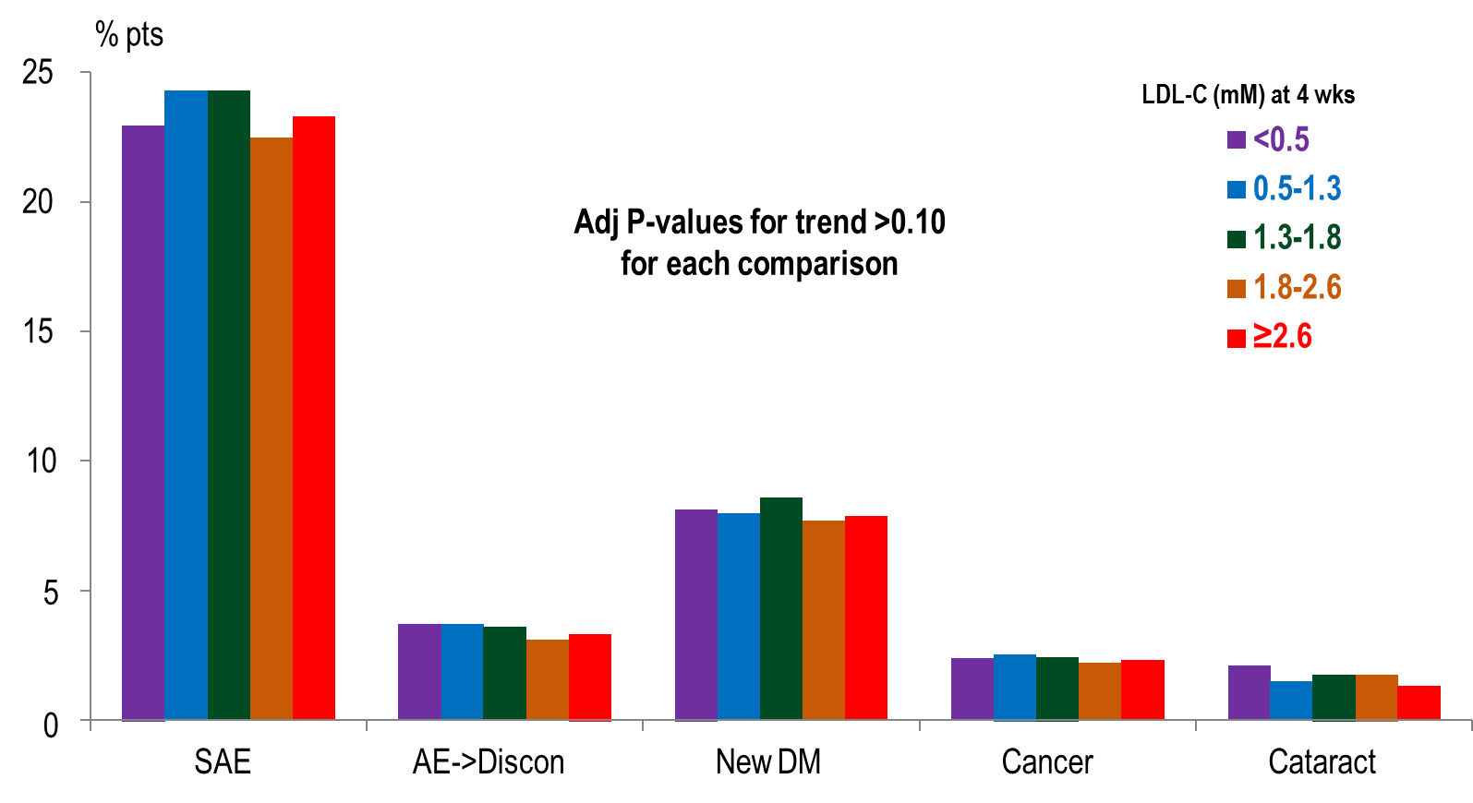
Detailed Safety Events from FOURIER Stratified by Achieved LDL-C (Part 1)
Giugliano et al Lancet 2017;390:1962-71
Notes:
Notes
:

Slide 31
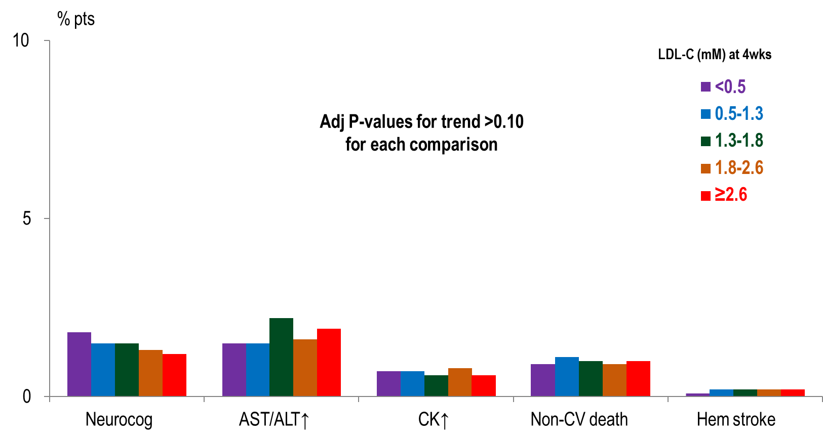
Detailed Safety Events from FOURIER Stratified by Achieved LDL-C (Part 2)
No safety concerns with very low LDL-C concentrations over a median of 2.2 years
Giugliano et al Lancet 2017;390:1962-71
Notes:
Notes
:

Slide 32
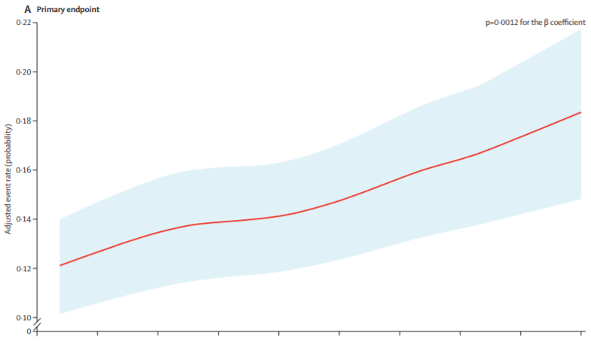
FOURIER Sub-Analyses: Relationship Between The Achieved LDL-Cholesterol Concentration at 4 Weeks and the Risk of the Primary Efficacy
Composite Endpoints
The primary efficacy endpoint was a composite of cardiovascular death, myocardial infarction, stroke, coronary revascularisation, or hospital admission for unstable angina.
The red line represents the adjusted probability of an event and blue areas are the 95% CIs of the regression model estimate.
Giugliano et al Lancet 2017;390:1962-71
Notes:
Notes
Results Of 27564 patients who were randomly assigned either evolocumab or placebo in the FOURIER trial between Feb 8, 2013, and June 5, 2015, 1025 (4%) patients did not have an LDL cholesterol measured at 4 weeks and 557 (2%) had already had a primary endpoint event or one of the ten prespecified safety events before the week-4 visit. There were no differences between treatment groups in the number of patients who did not have a week-4 LDL cholesterol measurement or in patients who had a clinical event before 4 weeks. The final analysis set consisted of 25982 patients (94% of those included at randomisation) of whom 13013 were randomly assigned evolocumab and 12969 were randomly assigned placebo. 2669 (10%) patients enrolled in FOURIER achieved an LDL cholesterol of less than 0·5 mmol/L at 4 weeks (figure 1). Of these 2669 patients, the median LDL cholesterol at 4 weeks was 0·36 mmol/L (IQR 0·28–0·44). The median LDL cholesterol over time for each of the five groups categorised by the LDL-cholesterol concentration at week 4 is shown in figure 2. Across the five groups of achieved LDL cholesterol at 4 weeks ordered from lowest to highest concentration groups, 2659 (99·6%) of 2669 patients, 7721 (96%) of 8003 patients, 1427 (41%) of 3444 patients, 782 (10%) of 7471 patients, and 424 (10%) of 4395 patients were randomly assigned evolocumab. The rates of study drug persistence were high during the trial (about 90% at 2 years) and similar across the five groups categorised by achieved LDL-cholesterol concentration at 4 weeks (appendix p 4). Baseline characteristics varied across the achieved LDL-cholesterol categories at week 4 (table 1). The risk of the primary composite efficacy endpoint after week 4 was lower with decreasing achieved LDL-cholesterol concentrations at week 4 (figure 3A). The Kaplan-Meier event rates at 3 years across the five groups of achieved LDL-cholesterol concentrations from lowest to highest groups were 10·3%, 12·4%, 13·6%, 13·7%, and 15·5% (ptrend <0·0001). The corresponding adjusted HRs using the group with LDL cholesterol of 2·6 mmol/L or greater as the reference group were 0·76 (95% CI 0·64–0·90), 0·85 (0·76–0·96), 0·94 (0·82–1·09), and 0·97 (0·86–1·09), for the next four groups from the lowest to the highest achieved LDL cholesterol (ptrend<0·0001; appendix pp 5–6). Regression modelling of the relation ship between achieved LDL cholesterol at 4 weeks and the subsequent risk of cardiovascular events showed a steady decline in risk as achieved LDL-cholesterol concentration decreased (p=0·0012 for the β coefficient),
even down to the first percentile (LDL cholesterol<0·2 mmol/L, figure 3A). A similar monotonic reduction in the key secondary endpoint was observed (figure 3B, p=0·0001 for the β coefficient), with the group achieving an LDL-cholesterol concentration of less than 0·5 mmol/L at 4 weeks having the lowest risk of cardiovascular death, myocardial infarction, or stroke (3-year Kaplan-Meier rate 6·6%) with an adjusted HR of 0·69 (95% CI 0·56–0·85) compared with the group with LDL-cholesterol concentrations of 2·6 mmol/L or higher (appendix p 5). These findings were associated with reductions in myocardial infarction, ischaemic stroke, and coronary revascularisation (appendix pp 5–6, with no apparent relationship between achieved LDL cholesterol and unstable angina, cardiovascular death, or all-cause mortality in the timeframe studied. Serious adverse events after week 4 occurred in 6106 (24%) patients. Less than 4% of all patients had an adverse event leading to drug discontinuation, and there were no differences in these events by achieved LDL-cholesterol concentration at 4 weeks (table 2). No differences in elevations in hepatic aminotransferases, creatine kinase, new-onset diabetes mellitus, cataractrelated adverse events, new or progressive malignancy, haemorrhagic stroke, or non-cardiovascular death were observed. In an unadjusted analysis, more patients had neurocognitive events who had lower LDL cholesterol at 4 weeks (ptrend=0·019); however, after adjustment for differences in baseline characteristics, the association was no longer significant (adjusted ptrend=0·15; table 2). To further explore the relationship between achieved LDL-cholesterol concentration and cognition, we also analysed 1154 patients who had formal cognitive testing as part of the EBBINGHAUS study, on or before the day of the first dose of study drug. No differences across the five groups of achieved LDL-cholesterol concentration at 4 weeks were observed in the change from baseline in the primary cognitive endpoint of spatial working memory strategy index of executive function, in any of the three secondary endpoints, or in the global composite score (appendix pp 7–8). Patient-reported changes in memory and three subdomains of executive function from the start to the end of the trial are shown in the appendix (p 9). The total score was significantly better in patients with lower achieved LDL cholesterol (ptrend=0·0168), although the absolute differences in mean scores were small and the relationship across LDL-cholesterol groups was not monotonic. In a post-hoc analysis of patients with ultra-low LDL cholesterol, 1335 (5%) patients achieved an LDL-cholesterol concentration of less than 0·4 mmol/L (15 mg/dL) and 504 (2%) patients achieved an LDL-cholesterol concentration of less than 0·26 mmol/L (10 mg/dL) at week 4 (appendix p 10). The median LDL-cholesterol concentration in the latter group was 0·18 mmol/L (7 mg/dL) with an IQR of 0·13–0·23 (5–9 mg/dL). Major p=0·0001 for the β coefficient), with the group achievingan LDL-cholesterol concentration of less than 0·5 mmol/L at 4 weeks having the lowest risk of cardiovascular death, myocardial infarction, or stroke (3-year Kaplan-Meier rate 6·6%) with an adjusted HR of 0·69 (95% CI 0·56–0·85) compared with the group with LDL-cholesterol concentrations
of 2·6 mmol/L or higher (appendix p 5). These findings were associated with reductions in myocardial infarction, ischaemic stroke, and coronary revascularisation (appendix pp 5–6, with no apparent relationship between achieved LDL cholesterol and
unstable angina, cardiovascular death, or all-cause mortality in the timeframe studied.
Serious adverse events after week 4 occurred in 6106 (24%) patients. Less than 4% of all patients had an adverse event leading to drug discontinuation, and there were no differences in these events by achieved LDL-cholesterol concentration at 4 weeks (table 2). No differences in elevations in hepatic aminotransferases, creatine kinase, new-onset diabetes mellitus, cataractrelated adverse events, new or progressive malignancy,
haemorrhagic stroke, or non-cardiovascular death were
observed. In an unadjusted analysis, more patients had
neurocognitive events who had lower LDL cholesterol at
4 weeks (ptrend=0·019); however, after adjustment for
differences in baseline characteristics, the association
was no longer significant (adjusted ptrend=0·15; table 2).
To further explore the relationship between achieved
LDL-cholesterol concentration and cognition, we also
analysed 1154 patients who had formal cognitive testing
as part of the EBBINGHAUS study, on or before the day
of the first dose of study drug. No differences across the
five groups of achieved LDL-cholesterol concentration at
4 weeks were observed in the change from baseline in
the primary cognitive endpoint of spatial working
memory strategy index of executive function, in any of
the three secondary endpoints, or in the global composite
score (appendix pp 7–8).
Patient-reported changes in memory and three subdomains
of executive function from the start to the end
of the trial are shown in the appendix (p 9). The total
score was significantly better in patients with lower
achieved LDL cholesterol (ptrend=0·0168), although the
absolute differences in mean scores were small and the
relationship across LDL-cholesterol groups was not
monotonic.
In a post-hoc analysis of patients with ultra-low LDL
cholesterol, 1335 (5%) patients achieved an LDL-cholesterol
concentration of less than 0·4 mmol/L (15 mg/dL) and
504 (2%) patients achieved an LDL-cholesterol
concentration of less than 0·26 mmol/L (10 mg/dL) at
week 4 (appendix p 10). The median LDL-cholesterol concentration
in the latter group was 0·18 mmol/L (7 mg/dL)
with an IQR of 0·13–0·23 (5–9 mg/dL). Major cardiovascular events progressively declined with decreasing achieved LDL-cholesterol concentrations, with adjusted HRs in the group with LDL-cholesterol concentrations of less than 0·26 mmol/L at 4 weeks of 0·69 (95% CI 0·49–0·97) for the primary and 0·59 (0·37–0·92) for the key secondary endpoints compared with the reference group (LDL cholesterol ≥2·6 mmol/L). Neither serious adverse events nor adverse events leading to drug discontinuation occurred in excess in these two groups with ultra-low LDL cholesterol compared with patients in the reference group.

Slide 33
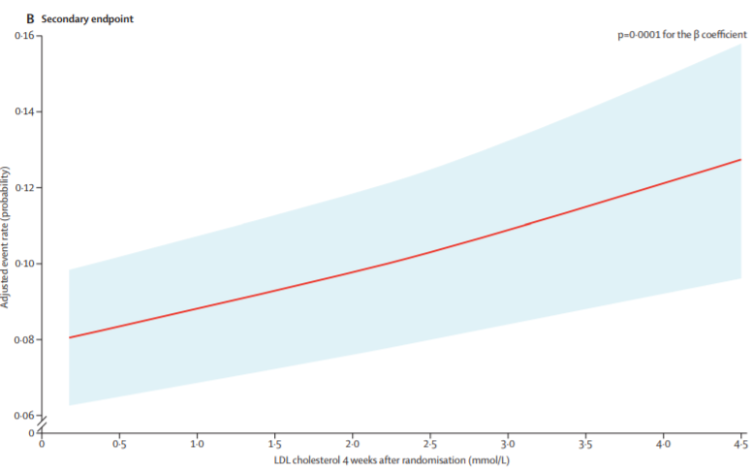
FOURIER Sub-Analyses: Relationship Between The Achieved LDL-Cholesterol Concentration at 4 Weeks and the Risk of the Key Secondary Efficacy Composite Endpoints
The key secondary efficacy endpoint was a composite of cardiovascular death, myocardial infarction, or stroke.
The red line represents the adjusted probability of an event and blue areas are the 95% CIs of the regression model estimate.
Giugliano et al Lancet 2017;390:1962-71
Notes:
Notes
Results Of 27564 patients who were randomly assigned either evolocumab or placebo in the FOURIER trial between Feb 8, 2013, and June 5, 2015, 1025 (4%) patients did not have an LDL cholesterol measured at 4 weeks and 557 (2%) had already had a primary endpoint event or one of the ten prespecified safety events before the week-4 visit. There were no differences between treatment groups in the number of patients who did not have a week-4 LDL cholesterol measurement or in patients who had a clinical event before 4 weeks. The final analysis set consisted of 25982 patients (94% of those included at randomisation) of whom 13013 were randomly assigned evolocumab and 12969 were randomly assigned placebo. 2669 (10%) patients enrolled in FOURIER achieved an LDL cholesterol of less than 0·5 mmol/L at 4 weeks (figure 1). Of these 2669 patients, the median LDL cholesterol at 4 weeks was 0·36 mmol/L (IQR 0·28–0·44). The median LDL cholesterol over time for each of the five groups categorised by the LDL-cholesterol concentration at week 4 is shown in figure 2. Across the five groups of achieved LDL cholesterol at 4 weeks ordered from lowest to highest concentration groups, 2659 (99·6%) of 2669 patients, 7721 (96%) of 8003 patients, 1427 (41%) of 3444 patients, 782 (10%) of 7471 patients, and 424 (10%) of 4395 patients were randomly assigned evolocumab. The rates of study drug persistence were high during the trial (about 90% at 2 years) and similar across the five groups categorised by achieved LDL-cholesterol concentration at 4 weeks (appendix p 4). Baseline characteristics varied across the achieved LDL-cholesterol categories at week 4 (table 1). The risk of the primary composite efficacy endpoint after week 4 was lower with decreasing achieved LDL-cholesterol concentrations at week 4 (figure 3A). The Kaplan-Meier event rates at 3 years across the five groups of achieved LDL-cholesterol concentrations from lowest to highest groups were 10·3%, 12·4%, 13·6%, 13·7%, and 15·5% (ptrend <0·0001). The corresponding adjusted HRs using the group with LDL cholesterol of 2·6 mmol/L or greater as the reference group were 0·76 (95% CI 0·64–0·90), 0·85 (0·76–0·96), 0·94 (0·82–1·09), and 0·97 (0·86–1·09), for the next four groups from the lowest to the highest achieved LDL cholesterol (ptrend<0·0001; appendix pp 5–6). Regression modelling of the relation ship between achieved LDL cholesterol at 4 weeks and the subsequent risk of cardiovascular events showed a steady decline in risk as achieved LDL-cholesterol concentration decreased (p=0·0012 for the β coefficient),
even down to the first percentile (LDL cholesterol<0·2 mmol/L, figure 3A). A similar monotonic reduction in the key secondary endpoint was observed (figure 3B, p=0·0001 for the β coefficient), with the group achieving an LDL-cholesterol concentration of less than 0·5 mmol/L at 4 weeks having the lowest risk of cardiovascular death, myocardial infarction, or stroke (3-year Kaplan-Meier rate 6·6%) with an adjusted HR of 0·69 (95% CI 0·56–0·85) compared with the group with LDL-cholesterol concentrations of 2·6 mmol/L or higher (appendix p 5). These findings were associated with reductions in myocardial infarction, ischaemic stroke, and coronary revascularisation (appendix pp 5–6, with no apparent relationship between achieved LDL cholesterol and unstable angina, cardiovascular death, or all-cause mortality in the timeframe studied. Serious adverse events after week 4 occurred in 6106 (24%) patients. Less than 4% of all patients had an adverse event leading to drug discontinuation, and there were no differences in these events by achieved LDL-cholesterol concentration at 4 weeks (table 2). No differences in elevations in hepatic aminotransferases, creatine kinase, new-onset diabetes mellitus, cataractrelated adverse events, new or progressive malignancy, haemorrhagic stroke, or non-cardiovascular death were observed. In an unadjusted analysis, more patients had neurocognitive events who had lower LDL cholesterol at 4 weeks (ptrend=0·019); however, after adjustment for differences in baseline characteristics, the association was no longer significant (adjusted ptrend=0·15; table 2). To further explore the relationship between achieved LDL-cholesterol concentration and cognition, we also analysed 1154 patients who had formal cognitive testing as part of the EBBINGHAUS study, on or before the day of the first dose of study drug. No differences across the five groups of achieved LDL-cholesterol concentration at 4 weeks were observed in the change from baseline in the primary cognitive endpoint of spatial working memory strategy index of executive function, in any of the three secondary endpoints, or in the global composite score (appendix pp 7–8). Patient-reported changes in memory and three subdomains of executive function from the start to the end of the trial are shown in the appendix (p 9). The total score was significantly better in patients with lower achieved LDL cholesterol (ptrend=0·0168), although the absolute differences in mean scores were small and the relationship across LDL-cholesterol groups was not monotonic. In a post-hoc analysis of patients with ultra-low LDL cholesterol, 1335 (5%) patients achieved an LDL-cholesterol concentration of less than 0·4 mmol/L (15 mg/dL) and 504 (2%) patients achieved an LDL-cholesterol concentration of less than 0·26 mmol/L (10 mg/dL) at week 4 (appendix p 10). The median LDL-cholesterol concentration in the latter group was 0·18 mmol/L (7 mg/dL) with an IQR of 0·13–0·23 (5–9 mg/dL). Major p=0·0001 for the β coefficient), with the group achievingan LDL-cholesterol concentration of less than 0·5 mmol/L at 4 weeks having the lowest risk of cardiovascular death, myocardial infarction, or stroke (3-year Kaplan-Meier rate 6·6%) with an adjusted HR of 0·69 (95% CI 0·56–0·85) compared with the group with LDL-cholesterol concentrations
of 2·6 mmol/L or higher (appendix p 5). These findings were associated with reductions in myocardial infarction, ischaemic stroke, and coronary revascularisation (appendix pp 5–6, with no apparent relationship between achieved LDL cholesterol and
unstable angina, cardiovascular death, or all-cause mortality in the timeframe studied.
Serious adverse events after week 4 occurred in 6106 (24%) patients. Less than 4% of all patients had an adverse event leading to drug discontinuation, and there were no differences in these events by achieved LDL-cholesterol concentration at 4 weeks (table 2). No differences in elevations in hepatic aminotransferases, creatine kinase, new-onset diabetes mellitus, cataractrelated adverse events, new or progressive malignancy,
haemorrhagic stroke, or non-cardiovascular death were
observed. In an unadjusted analysis, more patients had
neurocognitive events who had lower LDL cholesterol at
4 weeks (ptrend=0·019); however, after adjustment for
differences in baseline characteristics, the association
was no longer significant (adjusted ptrend=0·15; table 2).
To further explore the relationship between achieved
LDL-cholesterol concentration and cognition, we also
analysed 1154 patients who had formal cognitive testing
as part of the EBBINGHAUS study, on or before the day
of the first dose of study drug. No differences across the
five groups of achieved LDL-cholesterol concentration at
4 weeks were observed in the change from baseline in
the primary cognitive endpoint of spatial working
memory strategy index of executive function, in any of
the three secondary endpoints, or in the global composite
score (appendix pp 7–8).
Patient-reported changes in memory and three subdomains
of executive function from the start to the end
of the trial are shown in the appendix (p 9). The total
score was significantly better in patients with lower
achieved LDL cholesterol (ptrend=0·0168), although the
absolute differences in mean scores were small and the
relationship across LDL-cholesterol groups was not
monotonic.
In a post-hoc analysis of patients with ultra-low LDL
cholesterol, 1335 (5%) patients achieved an LDL-cholesterol
concentration of less than 0·4 mmol/L (15 mg/dL) and
504 (2%) patients achieved an LDL-cholesterol
concentration of less than 0·26 mmol/L (10 mg/dL) at
week 4 (appendix p 10). The median LDL-cholesterol concentration
in the latter group was 0·18 mmol/L (7 mg/dL)
with an IQR of 0·13–0·23 (5–9 mg/dL). Major cardiovascular events progressively declined with decreasing achieved LDL-cholesterol concentrations, with adjusted HRs in the group with LDL-cholesterol concentrations of less than 0·26 mmol/L at 4 weeks of 0·69 (95% CI 0·49–0·97) for the primary and 0·59 (0·37–0·92) for the key secondary endpoints compared with the reference group (LDL cholesterol ≥2·6 mmol/L). Neither serious adverse events nor adverse events leading to drug discontinuation occurred in excess in these two groups with ultra-low LDL cholesterol compared with patients in the reference group.

Slide 34
EBBINGHAUS
Evaluating PCSK9 Binding Antibody Influence On Cognitive Health in High Cardiovascular Risk Subject
EBBINGHAUS
Evaluating PCSK9 Binding Antibody Influence On Cognitive Health in High Cardiovascular Risk Subject
Purpose: Evaluate change over time in neurocognitive testing in subjects receiving statin therapy in combination with evolocumab, compared with subjects receiving statin therapy in combination with placebo
Subset of Patients Randomized in FOURIER
N = 1,972
Inclusion Criteria:
Male or female ≥ 40 to ≤ 85 years old
Randomized into FOURIER
Exclusion Criteria:
Current or known past diagnosis of dementia or mild cognitive impairment
Randomization 1:1
Evolocumab SC
Q2W or QM
+ effective statin dose
Total Follow-Up 4 years
Results before 2017
Placebo
Q2W or QM
+ effective statin dose
Primary endpoint: Mean change from baseline over time in Spatial Working Memory index of executive function
Secondary endpoints: Mean change from baseline over time in Spatial Working Memory between-errors score, mean change from baseline over time in paired associated learning total errors adjusted, and mean change from baseline over time in reaction time median 5-choice reaction time
Q2W, every 2 weeks; QM, every month; SC, subcutaneous.
ClinicalTrials.gov. https://clinicaltrials.gov/ct2/show/NCT022007634. Accesses February 2, 2016
Notes:
Notes:

Slide 35
EBBINGHAUS
Results and Conclusions
In patients with known cardiovascular disease on background statin followed for 20 months
No differences between evolocumab vs placebo
A battery of cognitive tests
Patient-reported everyday cognition
Adverse cognitive events reported by MD
No evidence of differences in cognitive tests by achieved nadir LDL-C, even 0.65 mmol/L

Slide 36
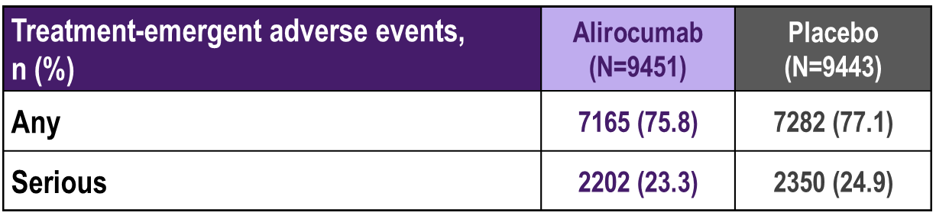
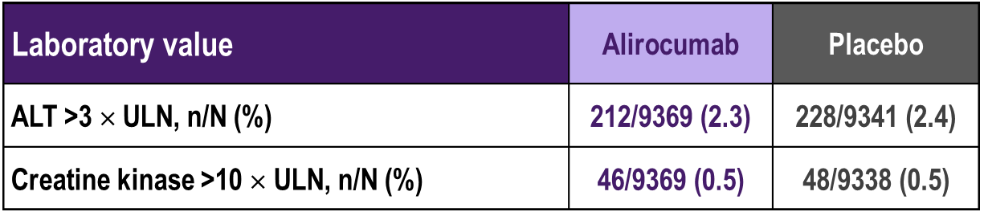
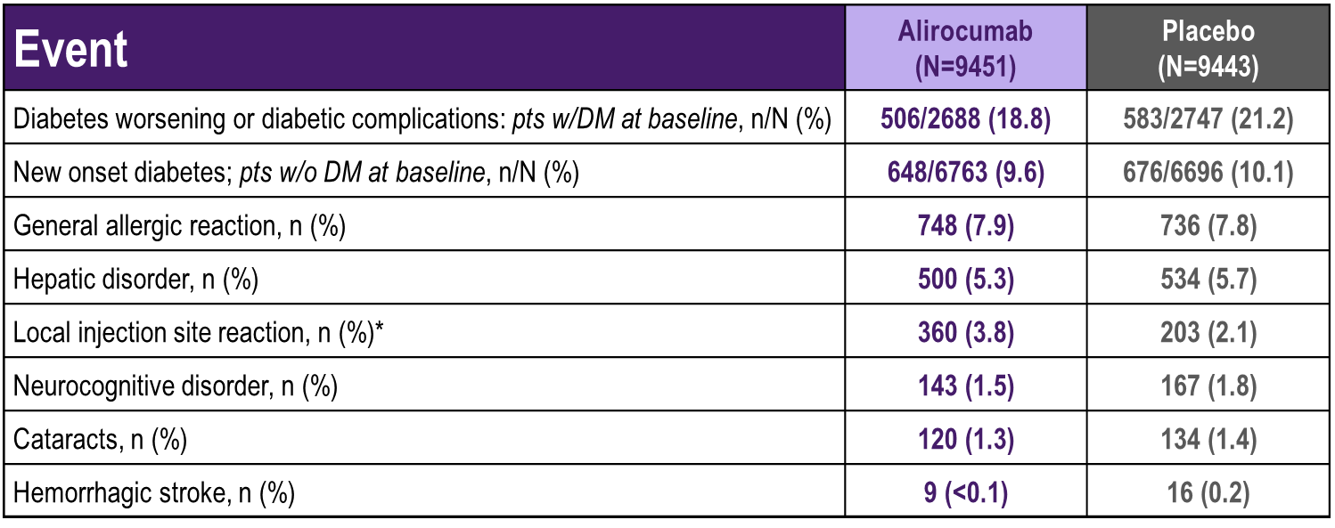
ODYSSEY Outcomes
Safety
Steg G. et al; On behalf of the ODYSSEY OUTCOMES Investigators and Committees - American College of Cardiology – 67th Scientific Sessions - March 10, 2018
Notes:
Notes
:

Slide 37
Summary
Evidence is emerging that very low LDL-C levels achieved with safe medications can lower residual CV risk substantially
Adjuncts to statin monotherapy, including PCSK9 inhibitors, are important therapies that will help achieve LDL-C goals
In clinical trials, there were no safety concerns with very low LDL-C concentrations (eg: <0.5 mmol/L) over a median of 2.2 years
Notes:
Notes

